Slide 1
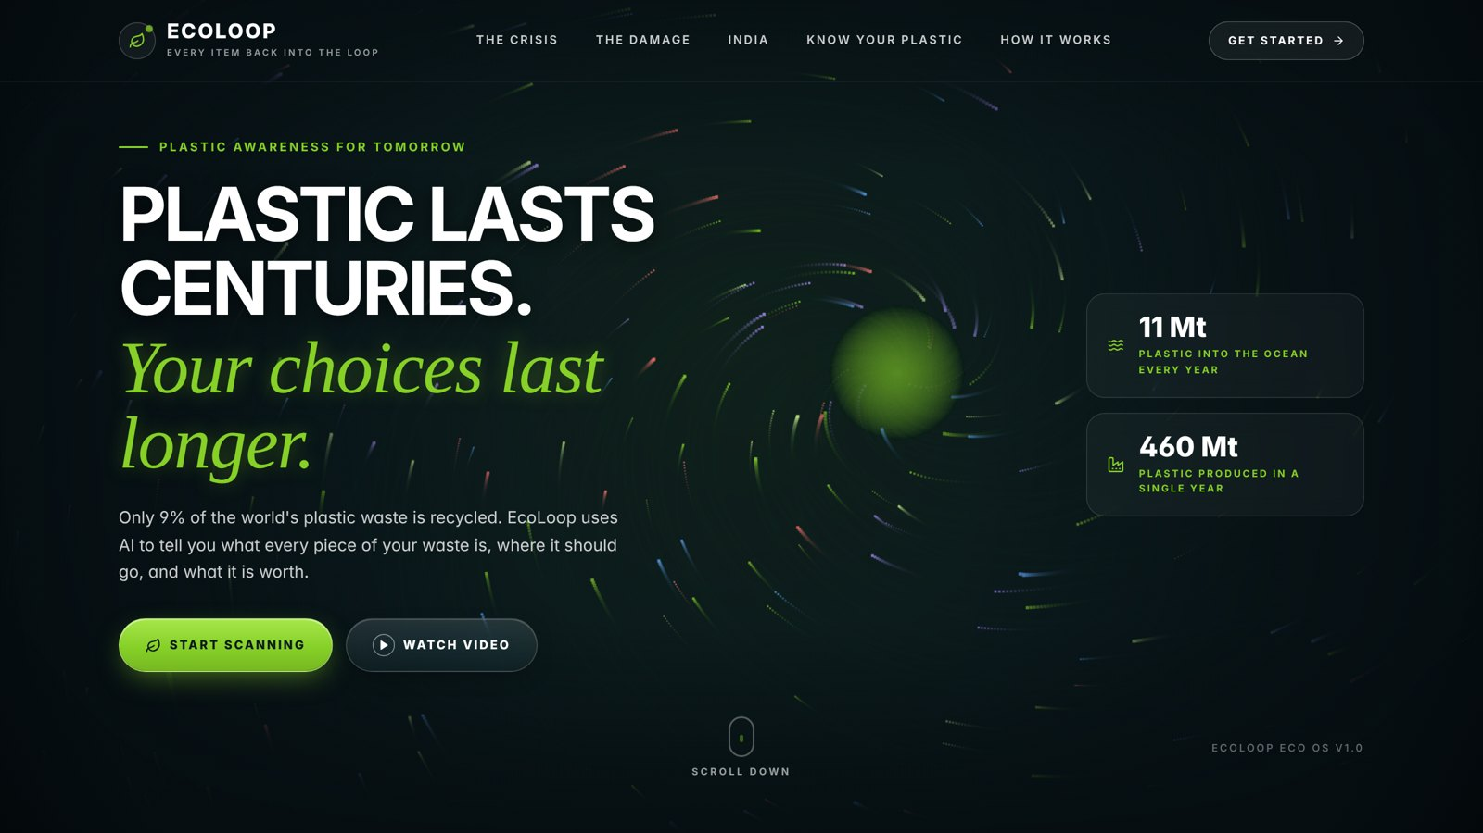
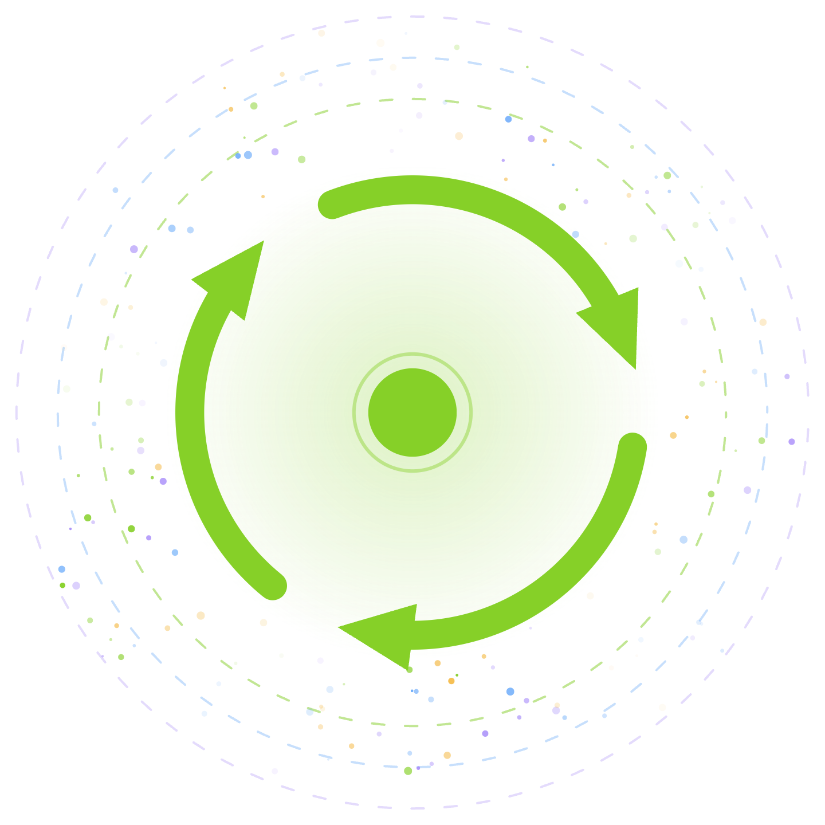
EcoLoop
SMART RECYCLING ASSISTANT · PS06
Every item back into the loop.
AI that sorts every item in one photo, tracks where it really goes, and coaches people to recycle better.
Suzuka · CBIT Kolar
Notes:
Hi, I'm Suzuka. This is EcoLoop, our answer to problem statement 06. One line: you take a photo of any pile of waste, and EcoLoop tells you what every item is, which bin it goes in, what it's worth, and where it ends up. Let me start with why this matters.

Slide 2
THE PROBLEM
460 Mt
9%
of plastic produced in 2019, double the 2000 level
22%
mismanaged: dumped, burned in the open or leaked into nature
of the world’s plastic waste is actually recycled.
11 Mt
of plastic enters the ocean every year
Sources: OECD Global Plastics Outlook (2022, 2019 data); Pew, Breaking the Plastic Wave (2020)
Notes:
Only 9 percent of the world's plastic waste is recycled. We produce 460 million tonnes a year, double what we made in 2000. 22 percent is mismanaged, and 11 million tonnes reach the ocean every year. Recycling technology exists. What fails is everything before it.

Slide 3
India emits 9.3 million tonnes of plastic pollution a year, about a fifth of the world’s total.
INDIA
Uncollected
3 bins by law
19 items banned
Most of it is waste that is never collected and ends up dumped or burned.
Since the SWM Rules 2016, homes must separate wet, dry and hazardous waste.
Single-use plastics like straws and cutlery, banned since July 2022.
Sources: Cottom et al., Nature (2024); Solid Waste Management Rules, 2016; Government of India SUP ban (2022)
Notes:
A 2024 study in Nature found India is the largest plastic polluter, 9.3 million tonnes a year, mostly because waste is never collected. The rules already exist: three bins since 2016, single-use plastic ban since 2022. The rules are there. What's missing is helping people follow them, item by item.

Slide 4
The problem isn’t bins. It’s the moment someone stands in front of one.
THE REAL GAP
“Is this recyclable?”
“Is it clean enough?”
“Where does a battery go?”
Notes:
The gap is not infrastructure, it's the moment of decision. Someone holds a bottle, a battery, a chip packet, and doesn't know. Click once to pop the three questions. One wrong item contaminates a whole bag of recyclables. And nobody ever finds out where their waste actually went. EcoLoop fixes that moment.

Slide 5



One photo. Every item sorted, tracked and explained.
THE SOLUTION
SEE
TRACK
COACH
Computer vision
Digital twin
Generative AI
Finds every object in a pile and sorts it into recyclable, reusable, biodegradable or hazardous.
Follows each item to recycling, compost, safe disposal or landfill, and simulates what-ifs.
Turns your own scan history into personal advice, in five Indian languages.
Notes:
EcoLoop has three parts that work as one loop. Computer vision sees every item. The digital twin tracks where each item goes. Generative AI coaches the person on what to change. The output of each feeds the next.

Slide 6

From a photo to a decision in seconds
HOW IT WORKS
01
02
03
04
05
Photo
Detect
Enrich
Twin
Coach
Camera or upload, any format, resized in the browser.
YOLO on the device plus Gemini Vision, merged box by box.
Material, weight, scrap value in ₹, CO₂e and disposal steps.
Each item becomes an event in the material flow model.
Gemini reads the twin and Indian rules, then advises.
Built with React, FastAPI, SQLite, YOLOv8 and Gemini. Works offline with YOLO if the internet drops.
Notes:
Five steps. The photo is converted and shrunk in the browser so it uploads fast. Detection runs two models: YOLO locally, which is fast and works offline, and Gemini Vision, which catches what YOLO misses and reads condition like "cap on" or "dirty". We merge them by box overlap. Each item gets enriched with material, weight, scrap value and CO2, becomes an event in the twin, and the coach reads the twin to give advice.

Slide 7
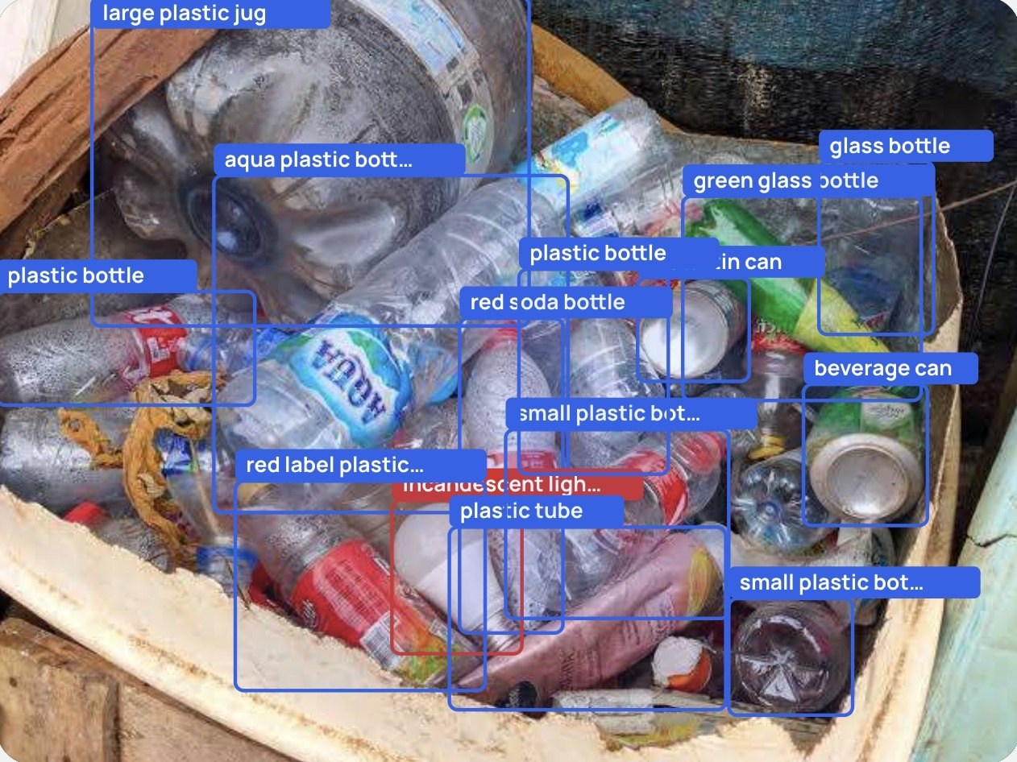
Sees every item in the pile
COMPUTER VISION
Four classes: recyclable, reusable, biodegradable, hazardous
Reads condition: cap on, food residue, wet, broken
Red alert for batteries, bulbs and e-waste
If the cloud fails, local YOLO keeps scanning
Real output: 14 items found in one cluttered photo
Notes:
This is a real result from our app: one photo of a mixed pile, 14 items found and labelled, including a bulb flagged as hazardous. It doesn't just say "plastic", it says "plastic bottle, cap on, rinse it first", because contamination is the main reason recycling fails. And if the internet drops, the local model keeps working.

Slide 8
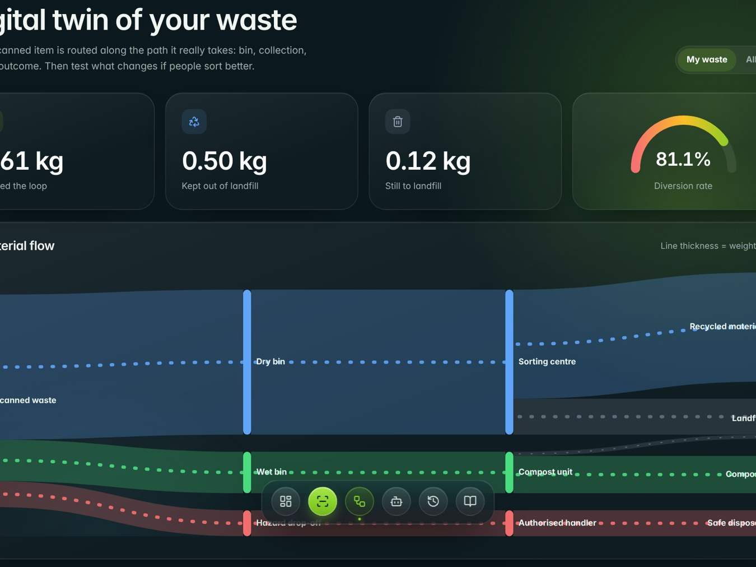
A living model of your waste stream
DIGITAL TWIN
Real system
Your household’s waste
Sensor
Camera + AI, on every scan
Model
Flow graph with real recovery rates
Sync
Updates with each new scan
Simulate
What-if sliders for behaviour change
Feedback
The AI coach closes the loop
Notes:
Be honest with judges here: this is a process twin, a digital shadow plus a simulator. The real system is your household waste stream. The sensor is the camera and AI. The model is a flow graph using real recovery rates. It syncs on every scan, lets you run what-if scenarios, and feeds back through the coach. With smart-bin weight sensors, it becomes a full twin, and that's on the roadmap.

Slide 9
If 1,000 homes sorted right for a month
WHAT-IF SIMULATION
Segregation raised from 20% to 60%, with 25% contamination, over 30 days
−38%
50%
~10 t
Less to landfill
Diverted from landfill
CO₂e avoided
29.4 t down to 18.1 t
Up from 18% today
In a single month
Today 29.4 t
EcoLoop 18.1 t
Illustrative output of the EcoLoop twin model. Recovery rates and assumptions are shown inside the app.
Notes:
This is the twin's simulator. One thousand households, one month. If segregation goes from 20 to 60 percent, landfill drops by 38 percent and diversion goes from 18 to 50 percent. The bars show landfill tonnes, today versus with EcoLoop. These are model outputs, not measurements, and I'll say that clearly. The point is that the twin lets a city or a campus test a policy before spending money on it.

Slide 10
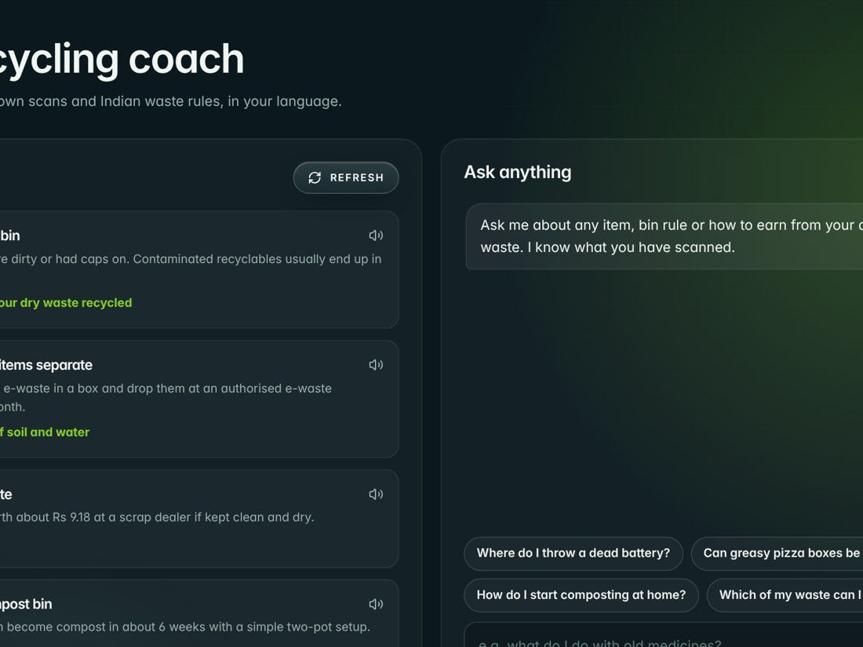
Advice from your own habits
GENERATIVE AI COACH
Reads your scans and twin, not generic tips
Follows SWM Rules 2016, E-Waste Rules 2022 and the plastic ban
English, Kannada, Hindi, Tamil and Telugu, with read-aloud
Rule-based fallback if the AI is unavailable
Notes:
The coach isn't a generic chatbot. It reads your scan history and twin, so it can say "you threw away 6 PET bottles this week, that's ₹2 and 0.5 kg CO2". It follows Indian rules, and speaks five languages with read-aloud, so a grandmother in Kolar can use it in Kannada.

Slide 11
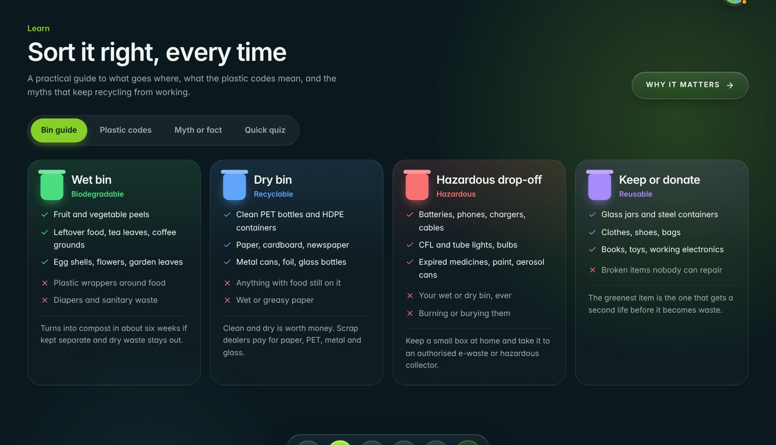
Teach the why, not just the bin
AWARENESS
Landing
Learn
The plastic crisis told with verified, sourced numbers.
Bin guide, resin codes 1–7, myth or fact, and a quiz.
Notes:
Sorting is a habit, and habits need understanding. The landing page explains the crisis with verified numbers. The Learn section covers the bin colours, what the numbers on plastic mean, common myths, and a quick quiz.

Slide 12
Sorting right pays
ITEM
RATE
PER ITEM
ECONOMICS
PET bottle
₹15/kg
≈ ₹0.38
Aluminium can
₹110/kg
≈ ₹1.65
Every scan shows what the item is worth to a local kabadiwala. Dirty items count at only 30%, so rinsing literally pays.
Newspaper (100 g)
₹13/kg
≈ ₹1.30
Cardboard
₹9/kg
by weight
Old phone
per piece
₹120
Indian scrap rates, Aug 2026: kabadidost.in, scrapbuddy.org, kabadiwalaonline.in
Notes:
Money motivates. These are real kabadiwala rates from August 2026. A can is worth more than a rupee and a half, an old phone 120 rupees. And because dirty items are worth only 30 percent, the app gives a real reason to rinse before you recycle.

Slide 13
Let’s scan a real pile
LIVE DEMO
1
Open the landing page and log in
2
Photograph a mixed pile: boxes, values and a hazard alert appear
3
Open the twin and drag the segregation slider
4
Ask the coach in Kannada and play it aloud
Notes:
Keep the demo under two minutes. Have a pile ready on the table with a bottle, a can, a carton and a battery or bulb so the hazard alert fires. If the network is slow, use a photo already saved on the phone. Use ngrok to open it on the phone.

Slide 14




From one home to a whole ward
WHAT’S NEXT
Live camera
Smart bins
Ward twins
Self-improving
Point and sort in real time, no photo needed.
Weight sensors make the twin fully live.
Dashboards for municipalities, campuses and dry waste centres.
User corrections retrain the detection model.
Notes:
Next steps: live camera mode, smart-bin sensors to turn the shadow into a full twin, ward-level twins for municipalities and dry waste collection centres, and using user corrections to retrain the model so it gets better with every scan.

Slide 15

Every piece counts.
Thank you.
ECOLOOP · SUZUKA · CBIT KOLAR
Notes:
Close with the line: every piece counts. One photo, one item at a time, and we can bring India's recycling up. Thank you, and I'm happy to take questions.

